Slide 1
Course Teacher: Md. Motaharul Islam, Ph.D. Associate Professor Department of Computer Science and Engineering
Interrupts
CSE – 341 : Microprocessors
BRAC University

Slide 2
Lecture References:
Book:
Microprocessors and Interfacing: Programming and Hardware, Author: Douglas V. Hall
Microprocessor and Microcomputer – Based System Design, Author: Mohamed Rafiquzzaman
CSE – 341 : Microprocessors
BRAC University

Slide 3
Interrupt and Its Classifications
Interrupt is a process where a normal program execution to be interrupted by some external signal or by a special instruction in the program.
Microprocessor pay attention to the interrupt stopping the current execution.
Classification of Interrupts
Interrupts can be classified into two types:
Maskable Interrupts (Can be delayed or Rejected)
User-defined interrupts
Non-Maskable Interrupts (Can not be delayed or Rejected)
System Interrupts
CSE – 341 : Microprocessors
BRAC University

Slide 4
Interrupt & Its Consequences over MP
An interrupt is considered to be an emergency signal that may be serviced.
The Microprocessor may respond to it as soon as possible.
What happens when MP is interrupted ?
When the Microprocessor receives an interrupt signal, it suspends the currently executing program and jumps to an Interrupt Service Routine (ISR) to respond to the incoming interrupt.
Each interrupt will have its own ISR.
After finishing the second program/interrupt, automatically return to the first program and start execution from where it was left
CSE – 341 : Microprocessors
BRAC University

Slide 5
Why Interrupt is Necessary?
To understand this we will have to review how µP/µC communicate with the outside world.
µP
BUS
MEMORY
I/O
DEVICES
CSE – 341 : Microprocessors
BRAC University

Slide 6
Why Interrupt is Necessary?
First Type: DEDICATED communication between MP and I/O devices.
µP
BUS
I/O
DEVICES
Single I/O device
CSE – 341 : Microprocessors
BRAC University

Slide 7
Why Interrupt is Necessary?
Second Type: POLLED I/O or PROGRAMMED I/O communication between MP and I/O devices.
BUS
µP
I/O
device1
...
I/O
device n
You?
You?
You?
Disadvantages of Second Type Communication:
not fast enough
waste too much microprocessor time
CSE – 341 : Microprocessors
BRAC University

Slide 8
Why Interrupt is Necessary?
Third Type: INTERRUPTED I/O communication between MP and I/O devices.
BUS
µP
INT
INT
I/O
device1
...
I/O
device n
INT
INT
INT
Interrupts are particularly useful when I/O devices are slow
CSE – 341 : Microprocessors
BRAC University

Slide 9
Polling and Interrupt
Both are methods to notify processor that I/O device needs attention
Polling
simple, but slow
processor check status of I/O device regularly to see if it needs attention
similar to checking a telephone without bells!
Interrupt
fast, but more complicated
processor is notified by I/O device (interrupted) when device needs attention
similar to a telephone with bells
CSE – 341 : Microprocessors
BRAC University

Slide 10
Classifications of 8086 Interrupts
An 8086 interrupt can come from any of the three sources:
An external signal applied to NMI or INTR pin.
known as hardware interruption
It is a user-defined interrupt
Execution of interrupt instruction INT.
referred as software interruption
It is also a user-defined interrupt
Some error condition produced by execution of an instruction, e.g., trying to divide some number by zero.
It is known as pre-defined interrupt
CSE – 341 : Microprocessors
BRAC University

Slide 11
Function of 8086 during Interrupts
At the end of each instruction cycle, 8086 checks to see if any interrupts have been requested.
If yes, then 8086 responds to the interrupt by stepping through the following series of major actions:
It decremented SP by 2 and pushes Flag register on the stack.
It disables 8086 INTR input by clearing IF (Interrupt) flag in Flag register
It resets the TF (Trap) flag in Flag register
It decremented SP again by 2 and pushes current CS (Code Segment) contents on the stack.
It decremented SP again by 2 and pushes current IP (Instruction Pointer) contents on the stack.
It does an indirect far Jump to the start of the procedure written to respond to the interrupt.
CSE – 341 : Microprocessors
BRAC University

Slide 12
Function of 8086 during Interrupts
1. Push FLAGS
2. Clear IF
3. Clear TF
4. Push CS
5. Push IP
6. Fetch ISR
address
Interrupt Service Routine (ISR)
main
Program
PUSH registers
...
...
...
....
...
POP registers
IRET
POP IP
POP CS
POP FLAGS
CSE – 341 : Microprocessors
BRAC University

Slide 13
Interrupt Vectors and Vector Table
An interrupt vector is a pointer to where the ISR is stored in memory.
All interrupts (vectored or otherwise) are mapped onto a memory area called the Interrupt Vector Table (IVT).
The IVT is usually located in the first 1 Kbyte of memory segment (from 00000 H - 003FF H).
The purpose of the IVT is to hold the vectors that redirect the microprocessor to the right place when an interrupt arrives.
The starting address of an ISR is often called
the interrupt vector or the interrupt pointer.
So the Table is referred to as
interrupt-vector table or interrupt-pointer table.
CSE – 341 : Microprocessors
BRAC University

Slide 14
Interrupt Types based on ISR ID
Note that
The IP value is put in as the low word of the vector
CS as high word of the vector
4 bytes are required to store the CS and IP values for each interrupt service procedure, the interrupt-vector table can hold starting addresses for up to 256 interrupt procedures.
Each Double Word interrupt vector is identified by a number from 0 to 255
INTEL calls this number the TYPE of the interrupt
CSE – 341 : Microprocessors
BRAC University

Slide 15
Interrupt Types based on ISR ID
AVAILABLE |  | 3FFH |  | TYPE 255
FOR USER |  |  |  | ...
(224) |  | 080H |  | TYPE 32
 |  |  |  | TYPE 31
RESERVED (27) |  |  |  | ...
 |  | 014H |  | TYPE 5
 |  |  |  | TYPE 4
 |  | 010H |  | INTO OVERFLOW
 |  |  |  | TYPE 3
Predefined/ |  | 00CH |  | INT
Dedicated/Internal |  |  |  | TYPE 2
Interrupts Pointers |  | 008H |  | NON-MASKABLE
(5) |  |  |  | TYPE 1
 |  | 004H |  | SINGLE STEP
CS Base Address |  |  |  | TYPE 0
IP Offset |  | 000H |  | DIVIDE ERROR
CSE – 341 : Microprocessors
BRAC University

Slide 16
Divide by zero interrupt- Type 0
It occurs automatically when the result of DIV or IDIV is too large
Example:
DIV BL //This will do AX÷BL
//will put result in AL(quotient) and AH(reminder)
If AX was 4000H and BL was 02H,
The quotient is 2000H and reminder is 00H.
µP can put 00H in AH(reminder)
But it cannot put 2000H in AL(quotient)
This condition is called divide error!

Slide 17
Single Step Interrupt- Type 1
In single step mode, a system will stop after it executes each instructions and wait for further direction
If the 8086 trap flag is set, the 8086 will automatically do a type 1 interrupt after each instruction executes
The trap flag is reset when the 8086 does a type 1 interrupt, so the single step mode will be disabled during the interrupt-service procedure
Tasks for implementing single stepping:
Set the trap flag
Write an interrupt service procedure which saves all registers on the stack
The stack where they can later be examined
Load the starting address of the type 1 interrupt service procedure into address 00004H and 00006H

Slide 18
Non-maskable Interrupt- Type 2
The 8086 will automatically do a type 2 interrupt response when it receives a low to high transition on its NMI input pin
The 8086 gets the CS value for the start of the type 2 interrupt service procedure from address 0000AH and the IP value for the start of the procedure from address 00008H
The type 2 interrupt response cannot be disabled by any program instruction that’s why we use it to signal the 8086 that some condition in an external system must be taken care of
The type 2 interrupt is useful to save program data in case of a system power failure

Slide 19
Breakpoint Interrupt- Type 3
The main use of type 3 interrupt is to implement a breakpoint function in a system
Unlike the single step feature, which stops execution after each instruction, the breakpoint feature executes all the instruction up to the inserted breakpoint and then stops execution
The 8086 gets the CS value for the start of the type 3 interrupt service procedure from address 0000EH and the IP value for the start of the procedure from address 0000CH
It is useful in debugging large programs when single stepping is inefficient

Slide 20
Overflow Interrupt- Type 4
The 8086 overflow flag (OF) will be set if the signed result of an arithmetic operation on two signed numbers is too large to be represented or memory location
The 8086 will get the CS value for the start of the type 4 interrupt service procedure from address 00012H and the IP value for the start of the procedure from address 00010H
It is useful to detect overflow error in signed arithmetic operations
There are two ways to detect and respond to an overflow error in a program
Put the jump if overflow instruction (JO) immediately after the arithmetic instruction
Put the interrupt on overflow instruction (INTO) immediately after the arithmetic instruction

Slide 21
Summary of 8086 Interrupt Function …
What happens if two or more interrupts occur at the same time?
Higher priority interrupts will be served first
Interrupt Type | Priority
DIVIDE ERROR, INTn, INT0 NMI INTR SINGLE STEP | HIGHEST LOWEST
CSE – 341 : Microprocessors
BRAC University

Slide 22
The 8259A Priority Interrupt Controller
Adds 8 vectored priority encoded interrupts to the microprocessor
Can be expanded without additional hardware to accept up to 64 IRQ (one 8259A master, and one slave)
D0-D7: Bidirectional data connections
IR0-IR7: Interrupt request inputs
WR΄: Write input strobe
RD΄: Read input connects to the IORC
INT: Output, connects to μP INTR pin
INTA΄: Input, connects to μP INTA΄ pin
A0: Command word select
CS΄: Chip select input
SP/EN΄: Slave program/enable buffer pin
CAS0-CAS2: Outputs from master to slave for cascading multiple 8259A chips
CSE – 341 : Microprocessors
BRAC University

Slide 23
Connecting a single 8259A controller
CSE – 341 : Microprocessors
BRAC University

Slide 24
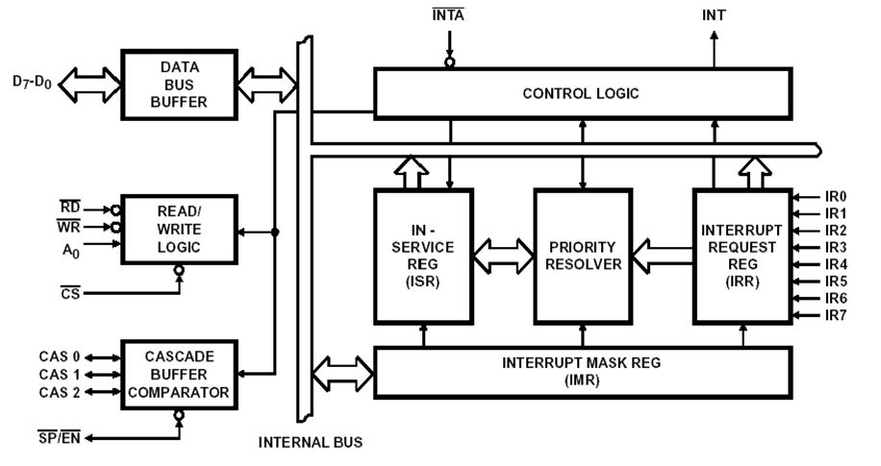
8259A Internal block diagram

Slide 25
The 8259A System Connections
The 8259A is used to increase the number of interrupts
The 8 bit data bus allows 8086 to send control words to the 8259A and read a status word from the 8259A and also allows to send interrupt types to the 8086
The RD’ and WR’ inputs control the transfer
When an interrupt occurs corresponding bit becomes 1 in (IR0-IR7), it checks IRR to know which interrupt has occurred, it checks IMR to know which interrupts are masked and it checks ISR to know which interrupts are in service
If the interrupt occurs is in higher priority, not masked and its in higher priority than the interrupt which was in service then its validate and it will be send to the µp on INTR

Slide 26
Example - 82C55 Keyboard Interrupt Circuit
CSE – 341 : Microprocessors
BRAC University

